Slide 1
Session 3: When Is an Ending Not an Ending
Mark 15–16

Slide 2
Mount Olives

Slide 3
Mount of Olives from road of Kidron Valley, looking toward Bethany

Slide 4
Garden of Gethsemane

Slide 5
Garden of Gethsemane

Slide 6
Garden of Gethsemane

Slide 7
Jerusalem from Mount of Olives

Slide 8
Road up to Jerusalem from Mount of Olives

Slide 9
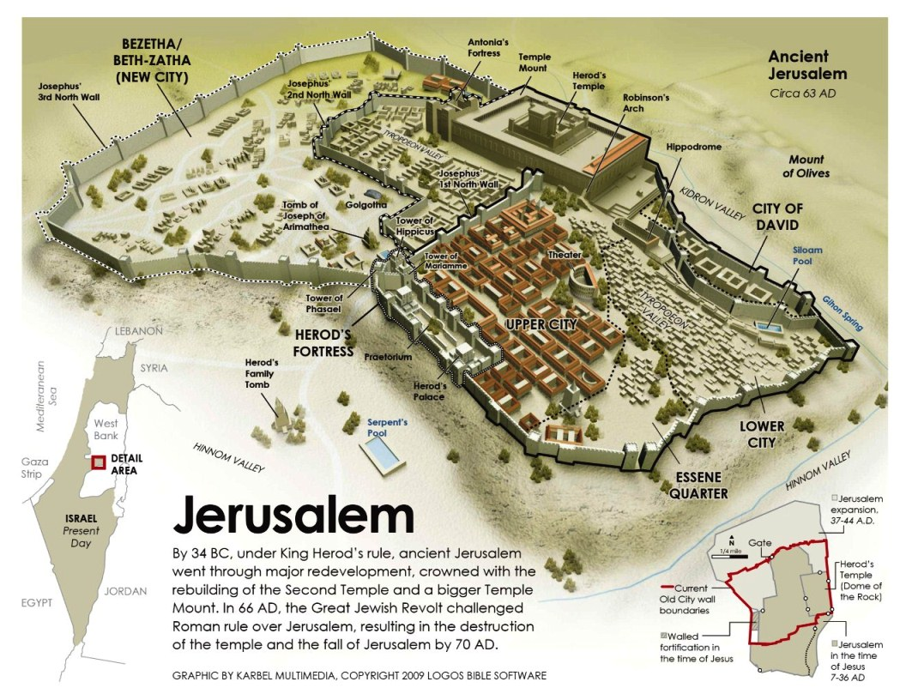

Slide 10
Closer view of Jerusalem

Slide 11
Church of the Holy Sepulcher

Slide 12
Inside Church of the Holy Sephuchre

Slide 13
Cross-section of Holy Sepulcher

Slide 14
Floor Plan – Church of the Holy Sepulcher

Slide 15
The “Garden Tomb”

Slide 16
Artist’s Rendering of Inside the Tomb

Slide 17
Tombs Along the Road to Jerusalem

Slide 18
Disc- type tomb seal Measuring 4.5-feet tall, the disk-shaped stone at the so-called Tomb of Herod’s Family could be rolled to cover the entryway of the tomb or rolled back into a niche to open it, thereby permitting new burials to be added to the family tomb. This is one of four Second Temple-period Jerusalem tombs with a round rolling stone. Photo: Hershel Shanks.
http://www.biblicalarchaeology.org/daily/biblical-sites-places/jerusalem/how-was-jesus-tomb-sealed/

Slide 19
“Plug-type” stone seal How was Jesus’ tomb sealed? While some Jerusalem tombs from the late Second Temple period boasted round (disk-shaped) rolling stones, it was more common to seal tombs with cork-shaped stones, such as the one pictured here. The archaeological evidence suggests that the tomb of Jesus—the unused tomb of Joseph of Arimathea—would have been sealed with a cork-shaped stone. Photo: Tom Powers.

Slide 20
Session 7: When Is an Ending Not an Ending
Mark 16

